Slide 1
DEEP LEARNING:
Single-frame infrared small target detection (SIRST)
Nguyễn Tống Minh - 20204885
Hoàng Trần Nhật Minh - 20204883
Nguyễn Hoàng Phúc - 20204923
Trương Quang Bình - 20200068
Hồ Minh Khôi - 20204917
TEAM 16 present
SOICT (2022)

Slide 2
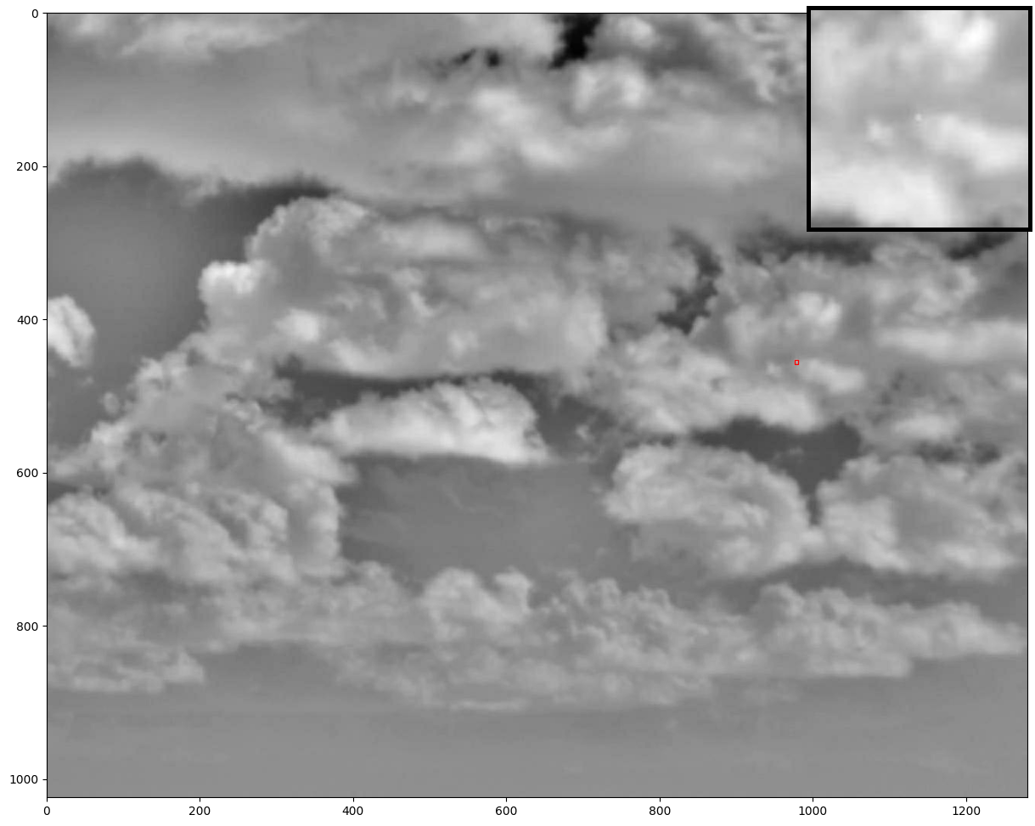
INTRODUCE
THE PROBLEM
TEAM 16 present
SOICT (2022)

Slide 3
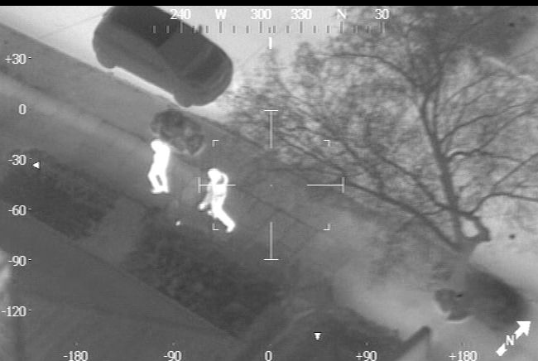
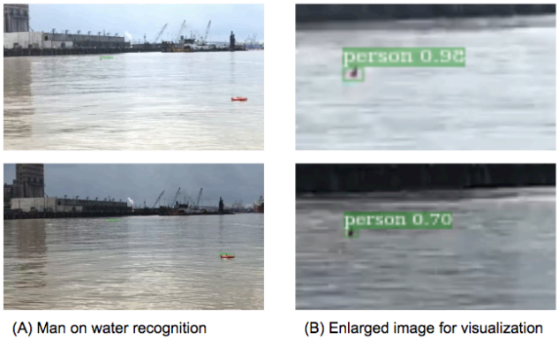
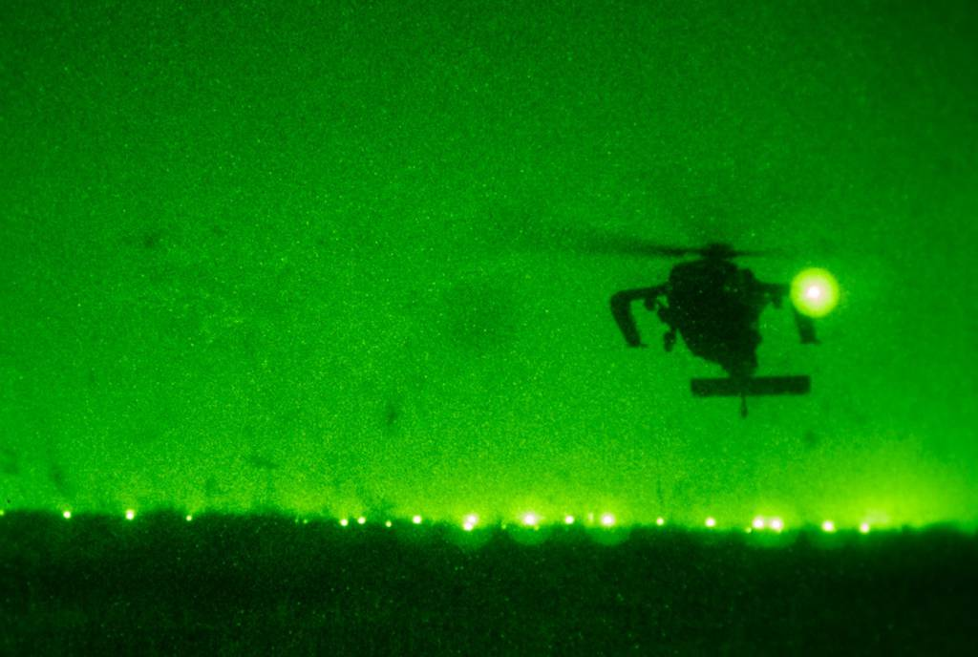
Infrared small target detection (IRST)
All objects emit IR radiation…
“HOTTER OBJECT, MORE IR”
MONITORING SYSTEM

Slide 4
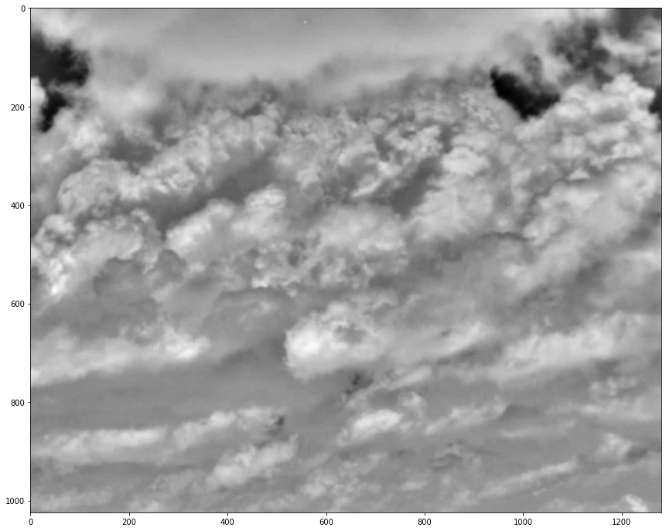
The Challenges
All objects emit IR radiation…
“HOTTER OBJECT, MORE IR”
small disrupted
targets
atmosphere noise
MONITORING SYSTEM

Slide 5
METHODOLOGY
MODEL
PROPOSAL
TEAM 16 present
SOICT (2022)

Slide 6
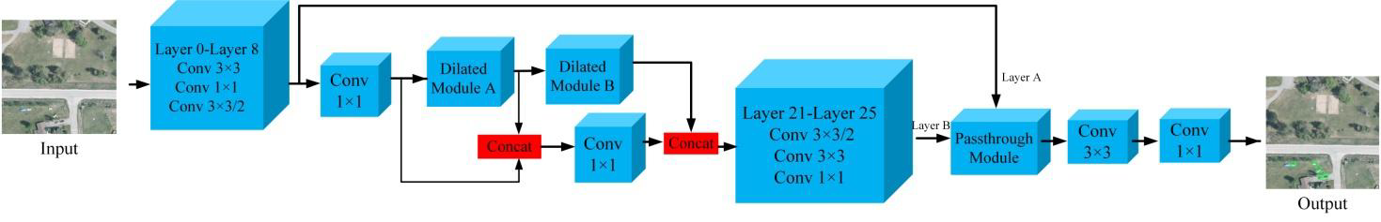
Simpeff
In 2019, "a simple and efficient network for small target detection" has been proposed by Moran Ju et al.

Slide 7
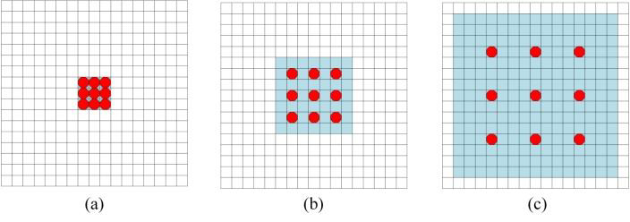
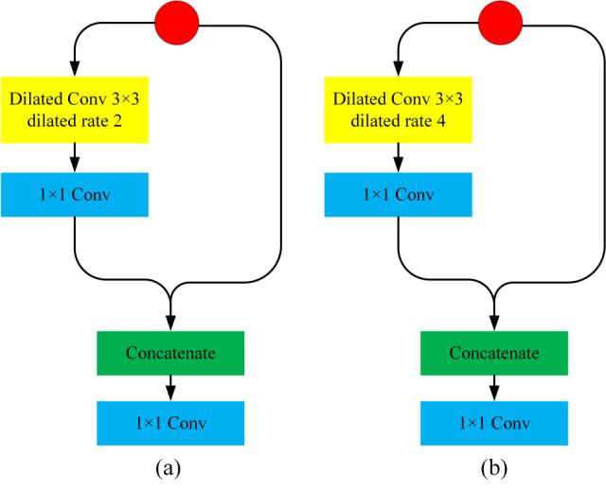
Simpeff
Dilated convolution: (a) dilated rate=1, (b) dilated rate=2, (c) dilated rate=4
Dilated module

Slide 8
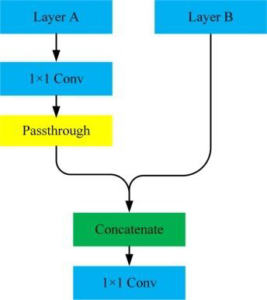
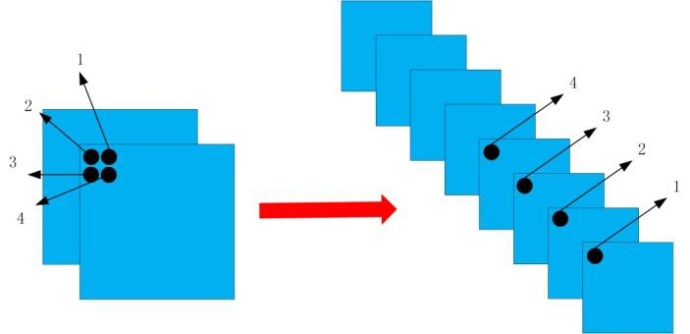
Simpeff
Passthrough layer Passthrough module

Slide 9
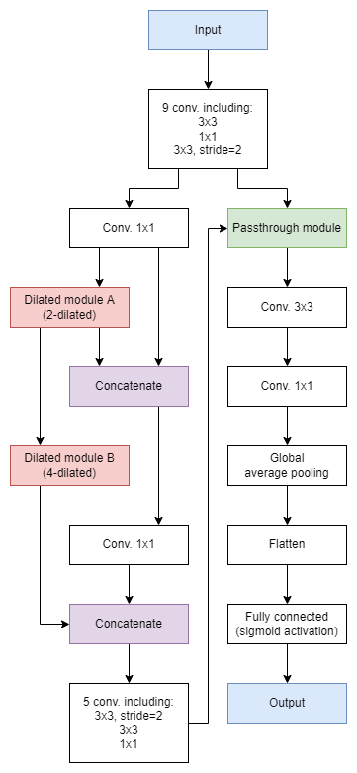
Simpeff
Simpeff architecture

Slide 10
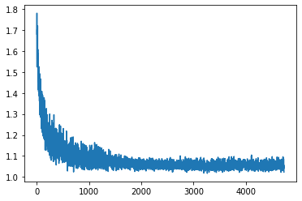
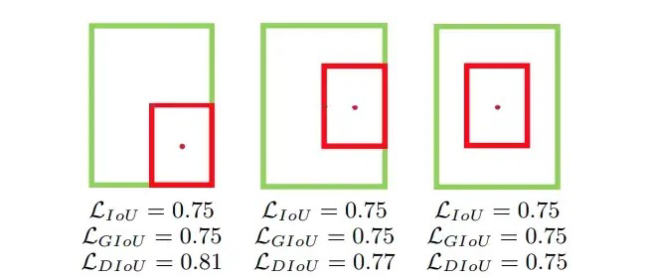
Simpeff
IoU, GIoU, and DIoU losses analysis
Simpeff uses DIoU loss to optimize

Slide 11
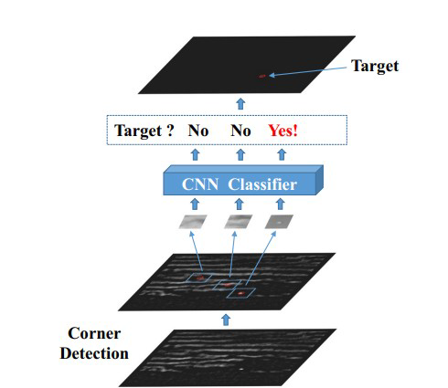
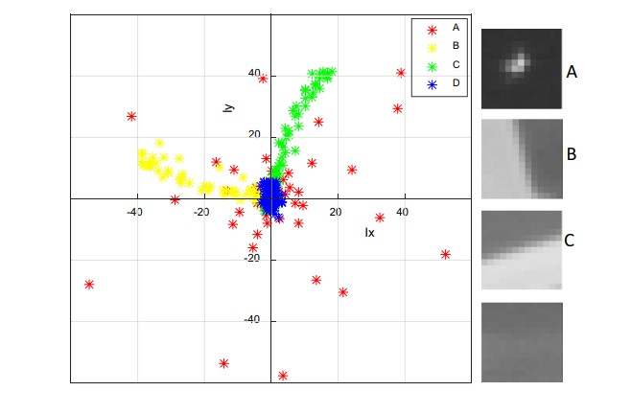
CCNN
target
edge
flat
Corner, pixels vary greatly in “gradient” amplitude and direction.

Slide 12


CCNN
CONTRAST ENHANCE
Signal is enhanced visually

Slide 13
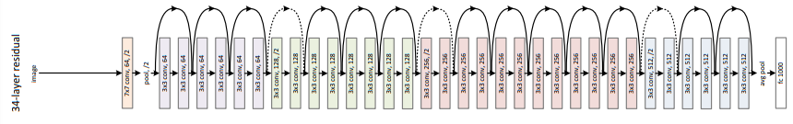
CCNN
skip connection
RESNET-34

Slide 14
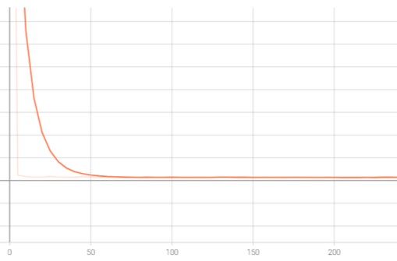
CCNN
DIoU Loss
CBE Loss
convergence
NAdam
frozen at first
open gradually

Slide 15
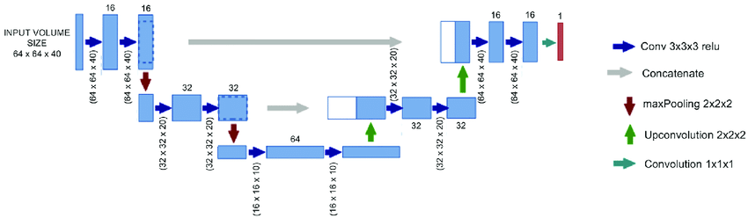
Unet Architecture

Slide 16
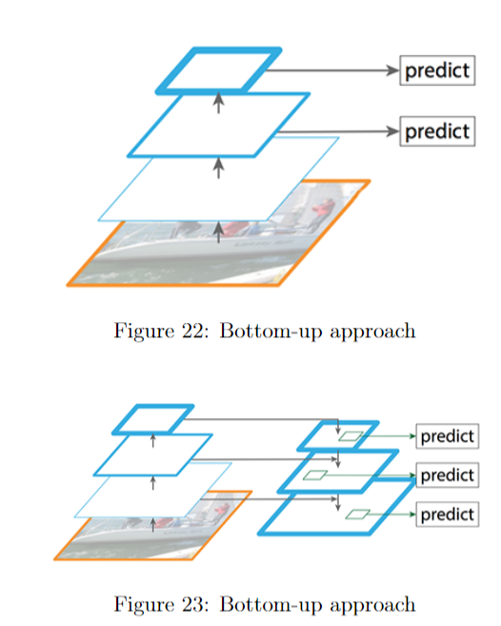
Feature Pyramid Network (FPN)

Slide 17
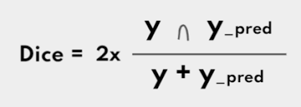
Dice Loss
The loss equal to “1 - Dice”.

Slide 18
EXPERIMENT
PRACTICAL RESULT
TEAM 16 present
SOICT (2022)

Slide 19
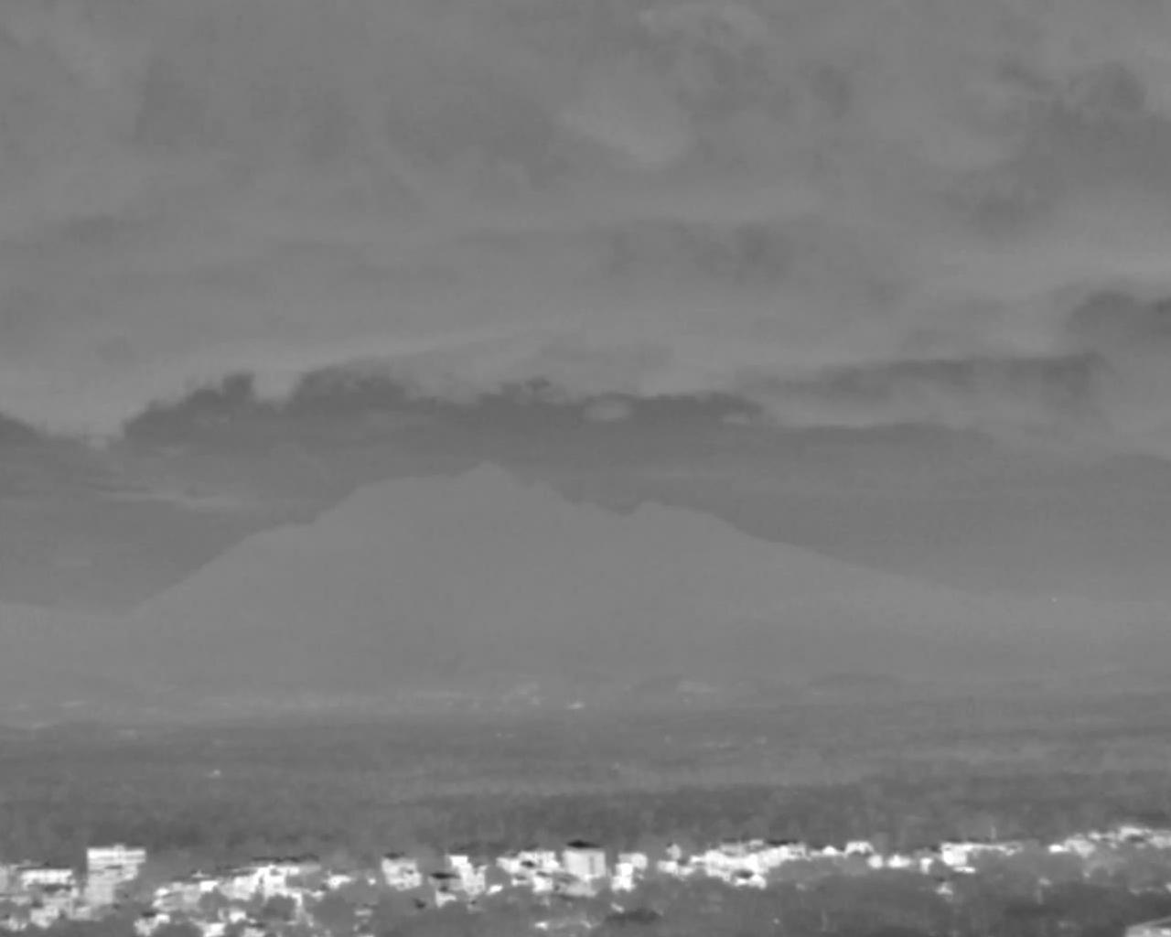

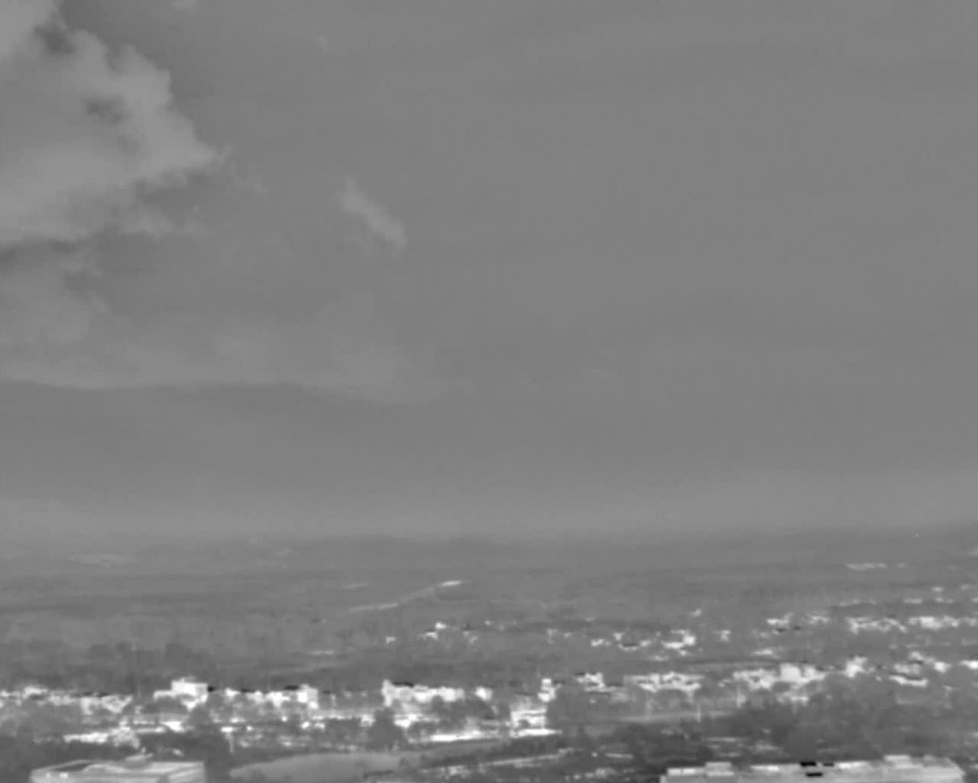
Data collection and processing
Many different angles, apart from clouds, buildings, etc.

Slide 20
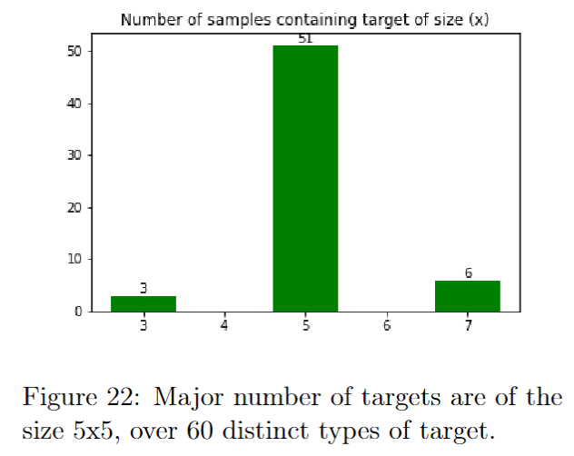
Data collection and processing
train-test split
90
10

Slide 21
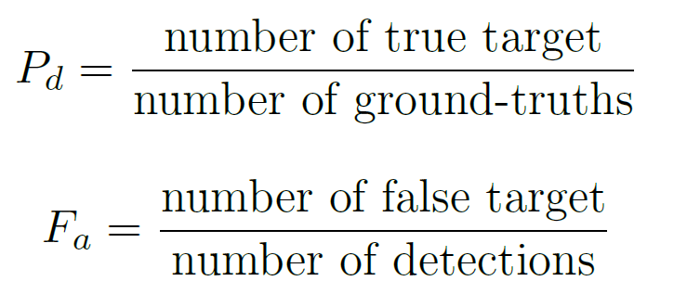

Model evaluation
Metrics: Detection Rate and False Alarm Rate
IoU threshold
> 0.0
> 0.5
1.0

Slide 22
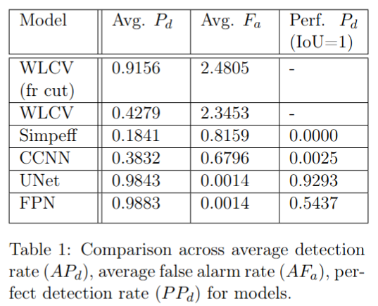
Comparison and analysis
All in all, the U-Net model yielded the best result overall, with a close runner-up in detection rate (98.43%), low false-alarm rate (0.14%), and top-end perfect-detection rate (92.93%).

Slide 23
DEMO
THE MODEL
TEAM 16 present
SOICT (2022)

Slide 24
DEEP LEARNING:
Single-frame infrared small target detection (SIRST)
END
TEAM 16 present
SOICT (2022)

